Slide 1
R Programming
Saravana

Slide 2
Learning Outcome
You can perform basic mathematical calculations in R
You will have basic knowledge of data types
You can manage variables in R

Slide 3
Overview
R Introduction
Comparison of R with other analytics software
Installation of R and R Studio
Installation of R packages
Basic R operations
R as a calculator
Datatypes in R
Variables in R

Slide 4
R language
R is a programming language and software environment for statistical analysis, graphics representation and reporting. R was created by Ross Ihaka and Robert Gentleman at the University of Auckland, New Zealand in 1993, and is currently developed by the R Development Core Team.
R is freely available under the GNU General Public License, and pre-compiled binary versions are provided for various operating systems like Linux, Windows and Mac.

Slide 5
Features
R is a well-developed, simple and effective programming language which includes conditionals, loops, user defined recursive functions and input and output facilities.
R has an effective data handling and storage facility,
R provides a suite of operators for calculations on arrays, lists, vectors and matrices.
R provides a large, coherent and integrated collection of tools for data analysis.
R provides graphical facilities for data analysis and display either directly at the computer or printing at the papers.
As a conclusion, R is world’s most widely used statistics programming language.

Slide 6
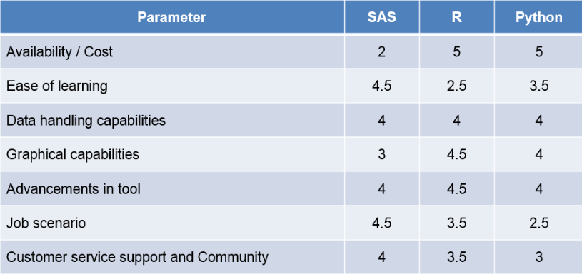
Comparison

Slide 7
R
R is a programming language for statistical calculation
You can
use R without using Rstudio
R Studio
RStudio is an Integrated Development Environment (IDE) that helps you develop programs in R
You can't use RStudio without using R

Slide 8
Basic Computations in R
Installing Packages in R
Basic R Operations
Data Types in R
Vectors & Matrices

Slide 9
Types of Operators:
Arithmetic Operators
Relational Operators
Logical Operators
Assignment Operators
Miscellaneous Operators

Slide 10
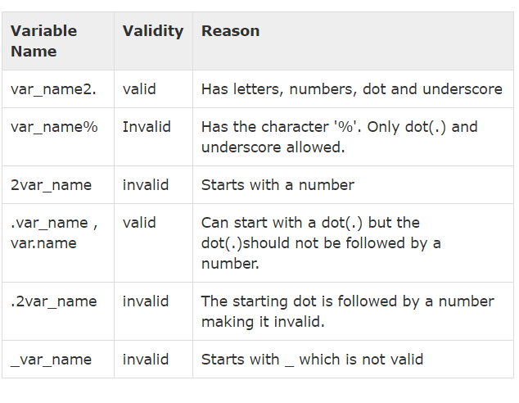
R Variables

Slide 11
Functions
Built-in Function
Simple examples of in-built functions are seq(), mean(), max(), sum(x) and paste(...) etc. They are directly called by user written programs.
dot(.), ls(), rm(),

Slide 12
Built in Functions in R

